Slide 1
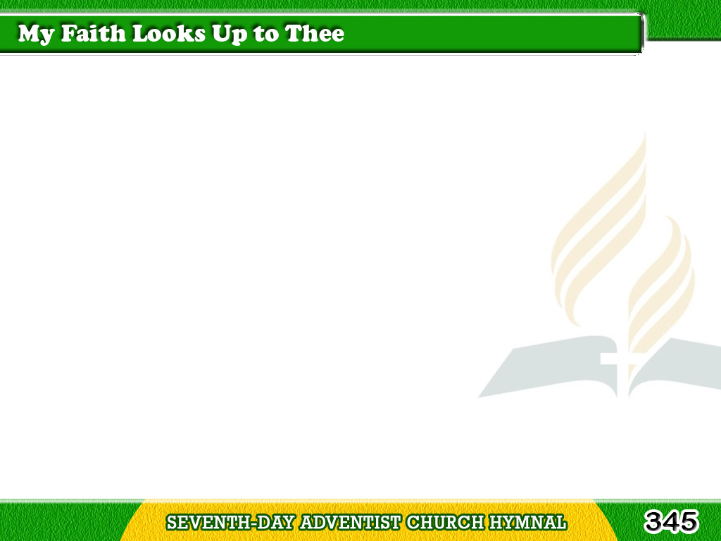
1/3
My faith looks up to Thee,
Thou Lamb of Calvary,
Savior divine;
Tagalog
Version

Slide 2
1/3
Now hear me while I pray,
Take all my guilt away,
O let me from this day
Be wholly Thine.
Tagalog
Version

Slide 3
2/3
May Thy rich grace impart
Strength to my fainting heart,
My zeal inspire;
Tagalog
Version

Slide 4
2/3
As Thou hast died for me,
O may my love to Thee
Pure, warm, and changeless be,
A living fire.
Tagalog
Version

Slide 5
3/3
While life’s dark maze I tread,
And griefs around me spread,
Be Thou my Guide;
Tagalog
Version

Slide 6
3/3
Bid darkness turn to day,
Wipe sorrow’s tears away.
Nor let me ever stray
From Thee aside.
Tagalog
Version

